Slide 1


NAVYAX
Home
Photo
About Us
Contact
THE ACADEMIC GAME CHANGER
NAVYAX
WITNESS PRODUCTIVITY LIKE NEVER BEFORE
Navisshna and Anya
Delhi Private School Dubai

Slide 2

NAVYAX
Home
Photo
About Us
Contact
THE PROMPT
HOW CAN WE INTEGRATE AI IN ACADEMICS TO EFFICIENTLY HELP STUDENTS AND TEACHERS???

Slide 3
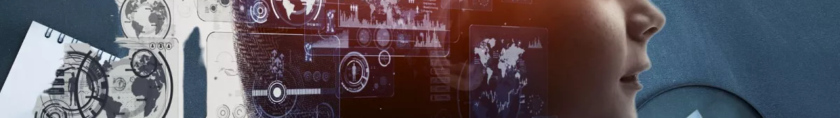
NAVYAX
Home
Photo
About Us
Contact
SO WHAT EXACTLY IS THE PROBLEM
STUDENTS FAIL TO FOCUS ON PARTS THEY NEED HELP ON AND TEND TO WASTE TIME ON TOPICS THEY ALREADY WELL VERSED WITH
IT IS DIFFICULT FOR TEACHERS TO MANUALLY INTERPRET THE LEARNING GAPS OF BIG SIZED CLASSES

Slide 4

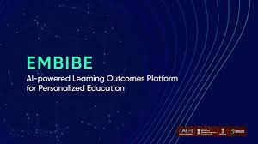

The Problem with already existing AI powered platforms

Slide 5
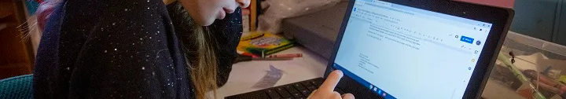
NAVYAX
Home
Photo
About Us
Contact
INCREASED SCREENTIME--> LEADS TO HEALTH ISSUES
MAKES STUDENTS VAULNERABLE TO DISTRACTIONS
THERE IS NO ALIGNMENT BETWEEN WHAT IS TAUGHT IN SCHOOL AND WHAT THE STUDENTS LEARN ONLINE, TEACHERS THUS OFTEN MISINTERPRET THE STUDENTS’ ABILITIES. MOREOVER IT BECOMES A TEDIOUS TASK FOR STUDENTS TO SIMULTANEOUSLY JUGGLE SCHOOL AND ONLINE COACHING

Slide 6
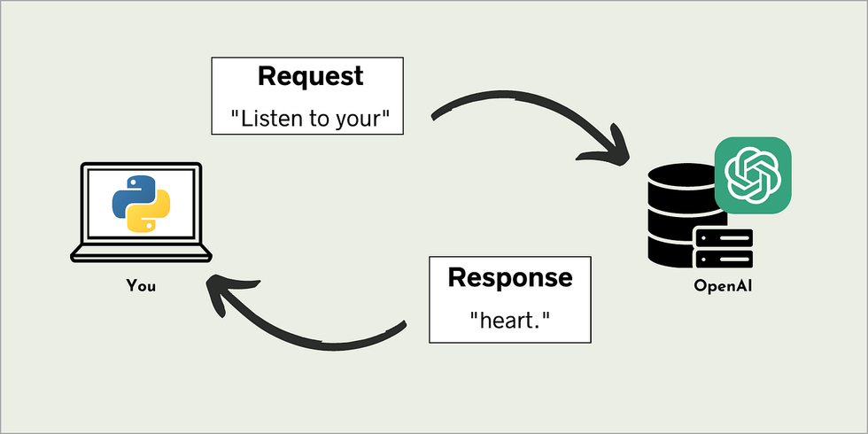

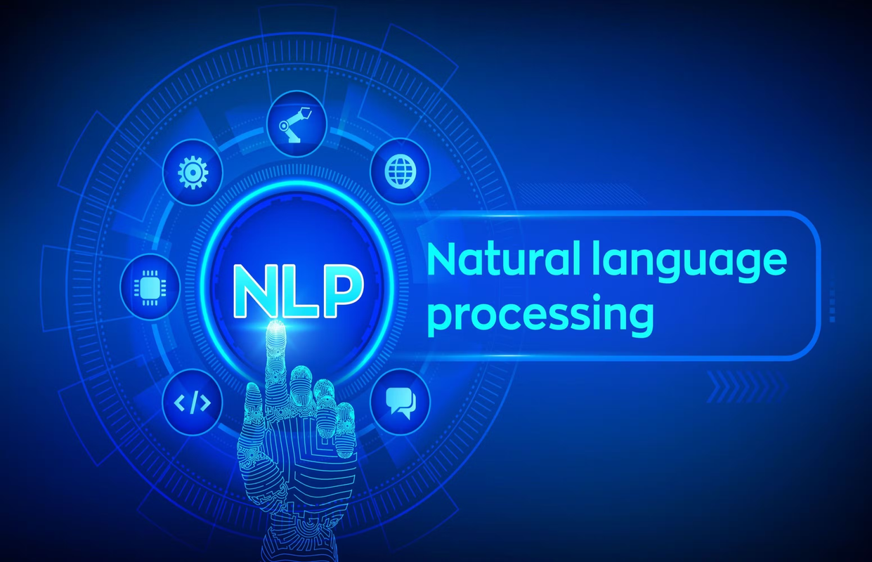
NAVYAX
Home
Photo
About Us
Contact
SOLUTION
We came up with NavyaX, an innovative AI Powered Class Assistant that helps cater to the learning gaps in students. The main purpose of Navyax is to help teachers identify which topics the class is needs help in so that teaching can be mended accordingly.
We have used a variety of Python LIbraries such as Pandas, Numpy, Tkinter,PyPDF, OpenAI etc.

Slide 7
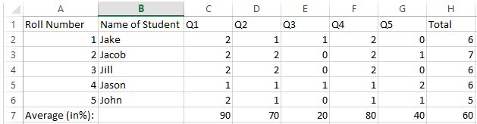
Home
Photo
About Us
Contact
UNDERSTANDING WHERE WE STAND USING A SMART QUESTIONWISE ANALYSIS SYSTEM
Segregating questions on the basis of the topics
Mark wise analysis of each question
WHERE THERE IS DATA, THERE IS OPPORTUNITY...

Slide 8
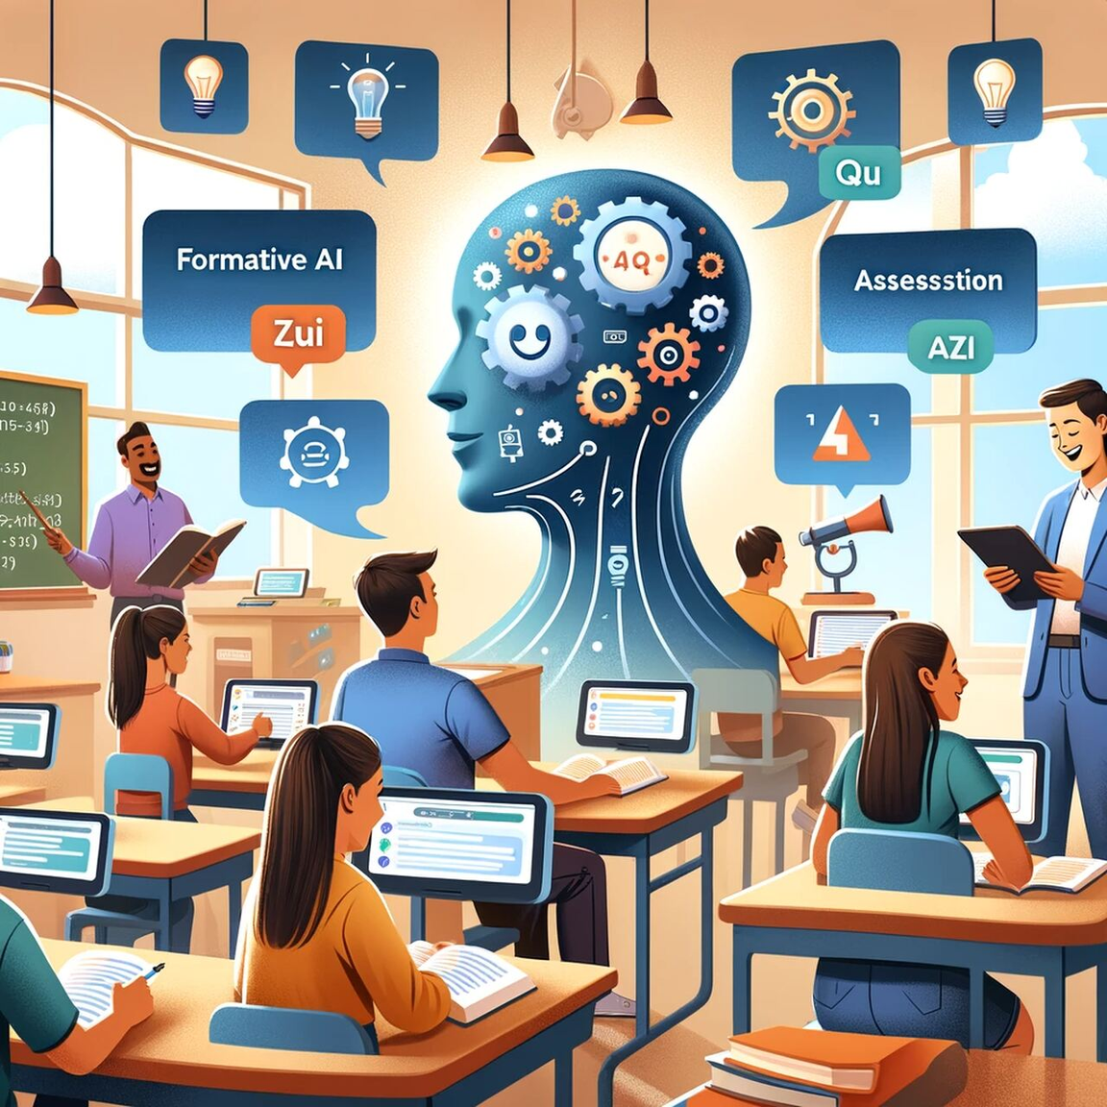
NAVYAX
Home
Photo
About Us
Contact
THE IMPACT OF OUR PROJECT
CAN BE INTERTWINED WITH THE EXISTING EDUCATION SYSTEM, HENCE DRASTIC CHANGES ARE NOT REQUIRED
MORE PERSONALIZED ATTENTION AND BETTER EFFICIENCY OF TEACHING , HENCE STUDENTS WILL FIND LEARNING EASIER AND FUN!
CAN BE APPLIED IN THE NEAR FUTURE, IT CAN HELP BOTH STUDENTS AND TEACHERS HENCE UPLIFTING THE WHOLE LEARNING ENVIRONMENT

Slide 9
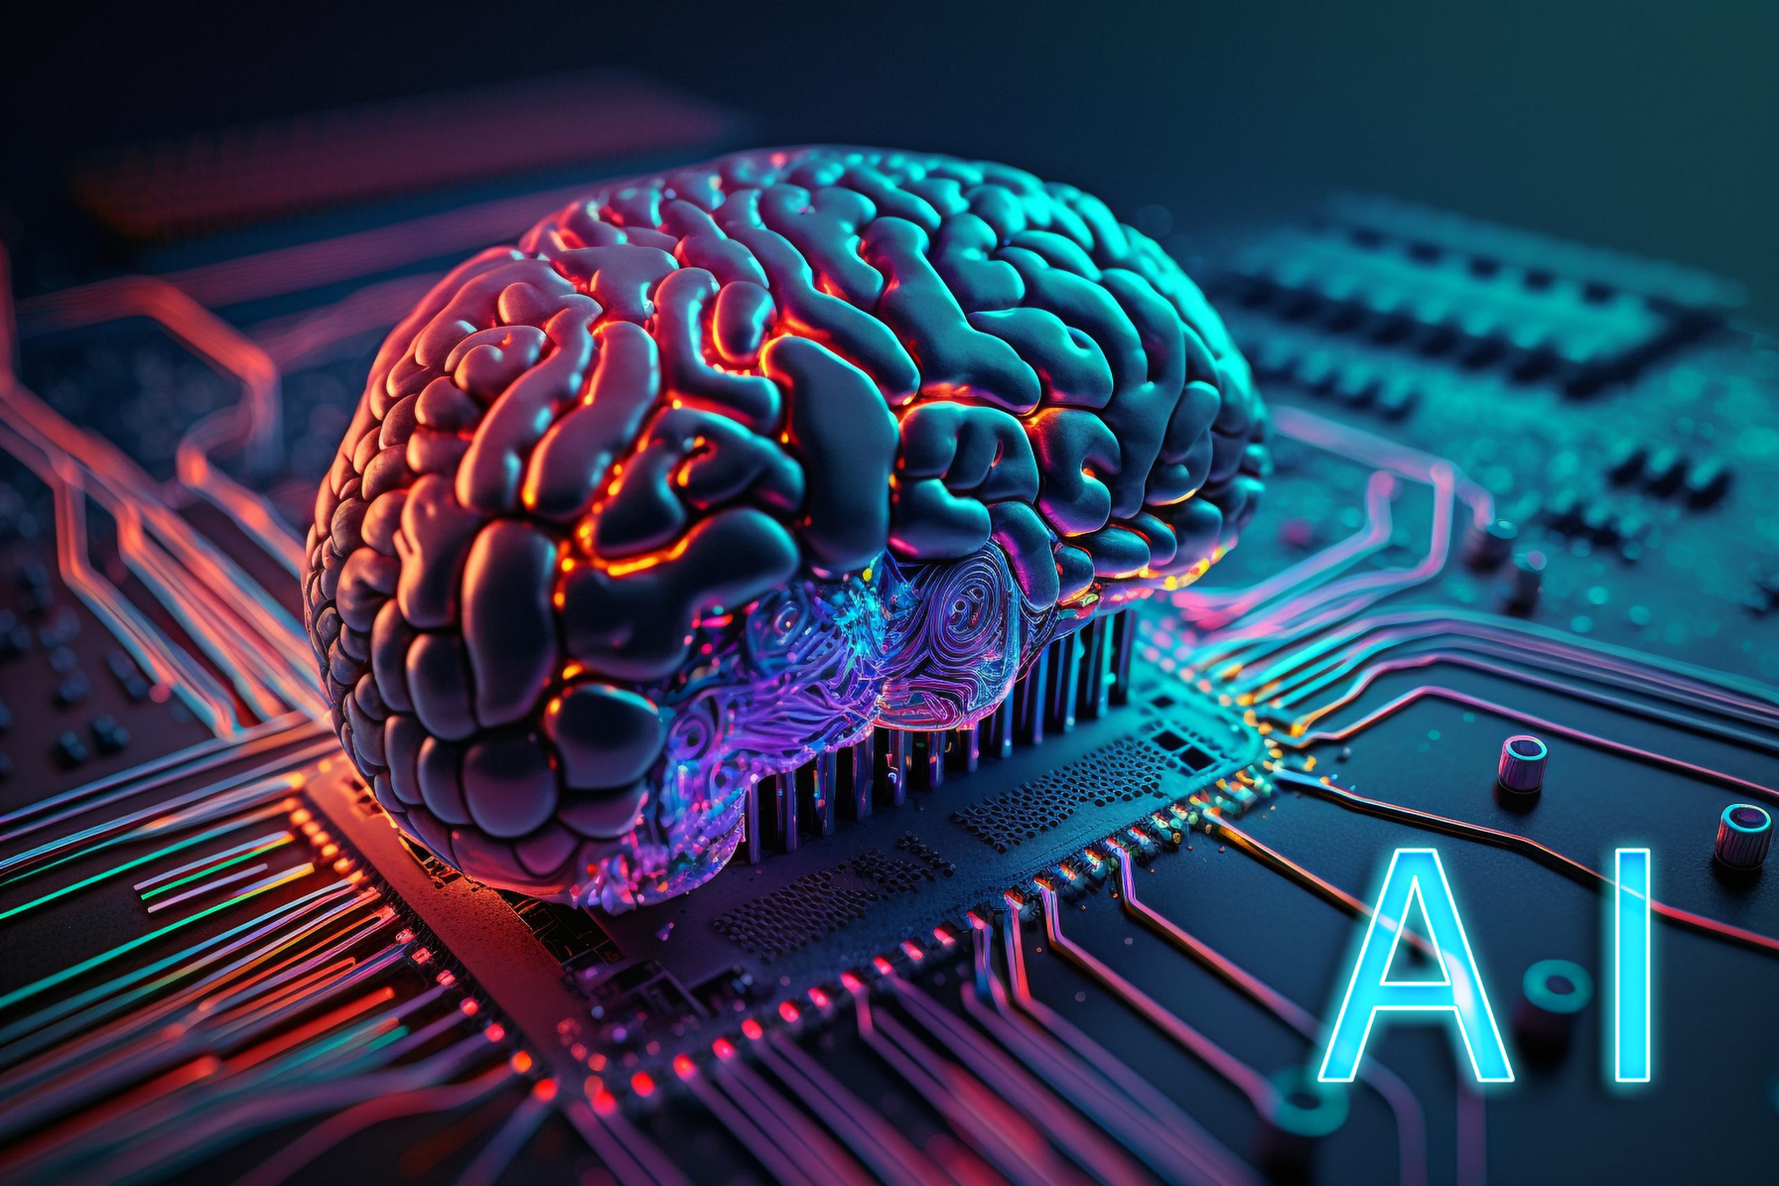
NAVYAX
Home
Photo
About Us
Contact
THE FUTURE
We thought of certain improvisations as well that could potentially improve the efficiency of NavyaX
INTEGRATING WITH REPORT CARDS FOR MORE PERSONLIZED ATTENTION
USING MACHINE LEARNING TO CREATE A PREDICTIVE MODEL TO IDENTIFY STUDENTS WHO NEED THE MOST HELP AND IN WHICH SPECIFIC TOPIC

Slide 10

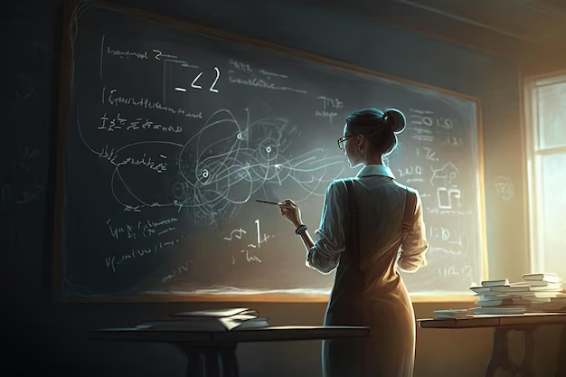

NAVYAX
Home
Photo
About Us
Contact
THANKYOU

